Slide 1
An introduction to Deep Learning in Natural Language Processing: Models, Techniques, and Tools
Abhinab Acharya, Spandan Pyakurel, Sujan Dutta

Slide 2
What is Natural Language Processing (NLP)?
A branch of artificial intelligence that involves the design and implementation of algorithms and systems able to understand and interact through human languages.

Slide 3
Tasks and Applications
1. Sequence Classification
Input: A sequence of tokens (words).
Output: A set of possible classes.
Examples: Sentiment analysis, document classification, etc.
Most of modern NLP applications can be categorized in four classes.

Slide 4
Tasks and Applications
2. Pairwise Sequence Classification
Input: A pair of sequences. Each sequence is a series of tokens.
Output: A set of possible classes.
Examples: Textual entailment, document similarity, etc.
Most of modern NLP applications can be categorized in four classes.

Slide 5
Tasks and Applications
3. Word labeling
Input: A sequence of tokens.
Output: A label for each token.
Examples: Parts of speech tagging, named entity recognition, etc.
Most of modern NLP applications can be categorized in four classes.

Slide 6
Tasks and Applications
3. Seq2Seq
Input: A sequence of tokens.
Output: A sequence of token.
Examples: Translation, summarization, etc.
Most of modern NLP applications can be categorized in four classes.

Slide 7
An Example
pron
adj
verb
noun
noun
pos tagging
sentiment analysis
I really like David’s cat!
positive
translation
আমি ডেভিডের বিড়াল পছন্দ করি!

Slide 8
Advances in NLP:
Earlier approaches used to represent words as one-hot encoded vectors (bag-of-words)
These vectors are huge!
Different words have orthogonal representations limiting similarity computation.
The context is not taken into account.

Slide 9
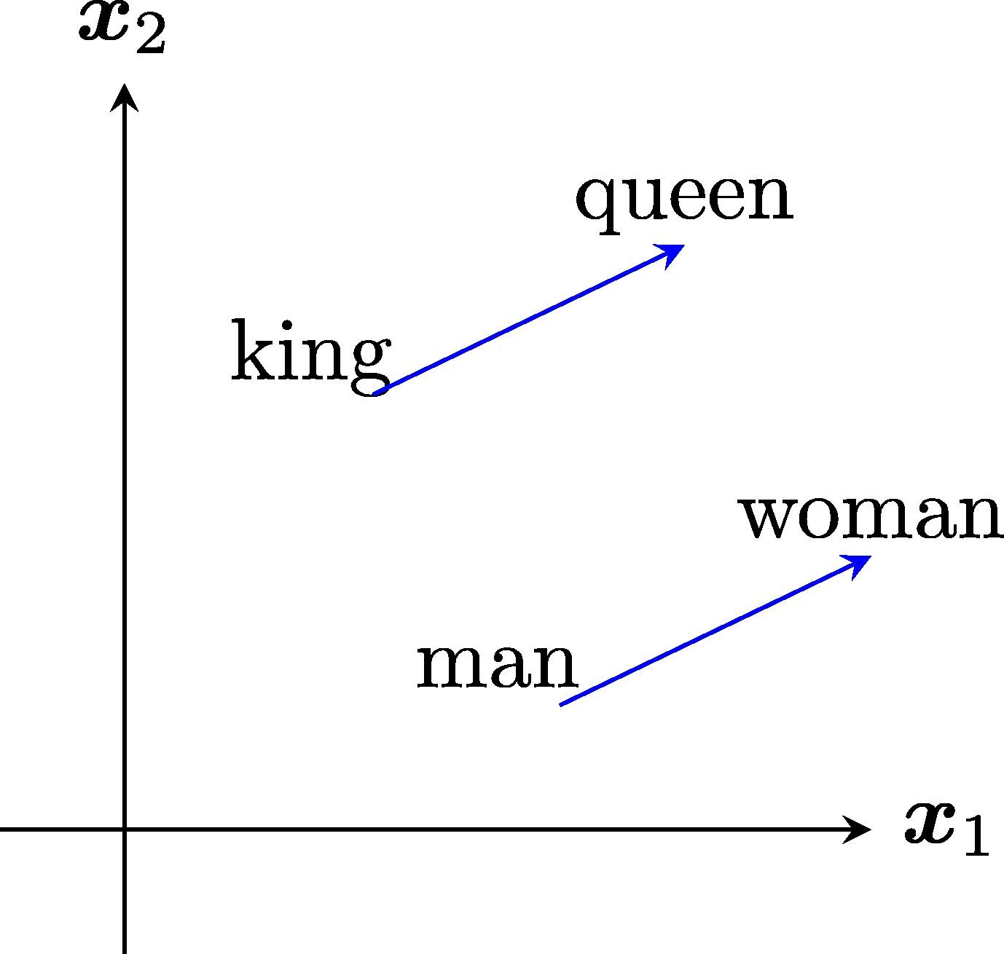
Advances in NLP: Word and Sentence Vectors
Word2Vec introduced the concept of word vectors.
Representing every word in vectors space with fixed dimension.
Similar words will be closer to each other.
It even has a sense of meaning in directions v_king – v_queen = v_man – v_woman
Later we saw GloVe, FastText, etc.

Slide 10
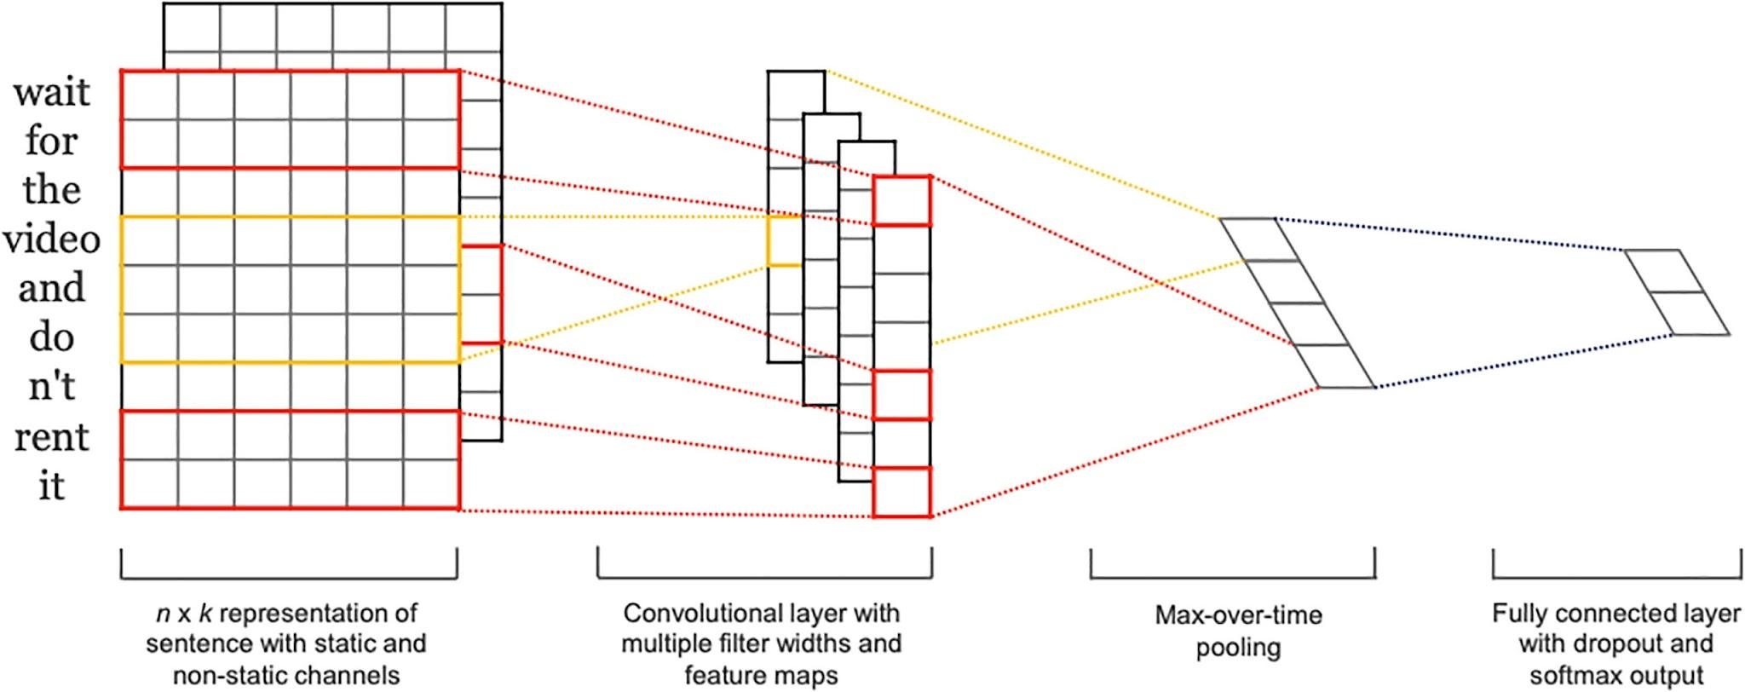
Advances in NLP: Word vectors with neural nets
Combining neural networks with word vectors showed improvements in supervised learning.
CNNs have been used to generate feature maps from input word vectors.

Slide 11
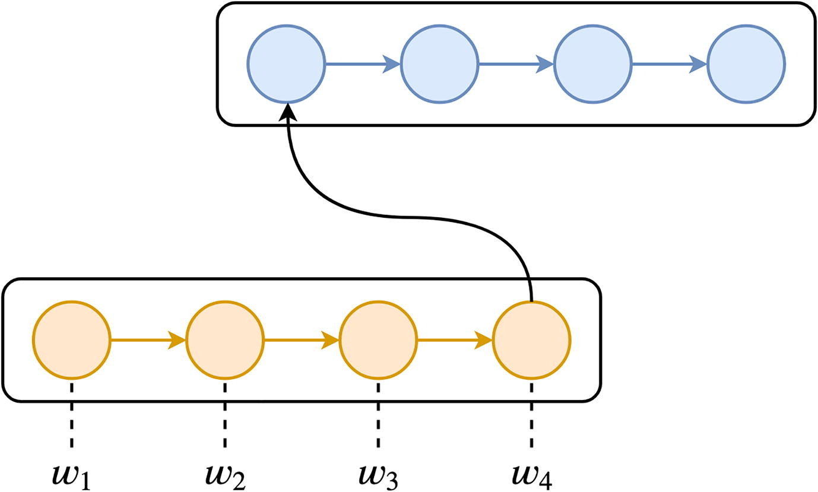
Advances in NLP: Word vectors with neural nets
Encoder-decoder architecture have been proposed for machine translation.
The encoder part (RNN) encodes the source language word vectors and the decoder (RNN) decodes this to target language.

Slide 12
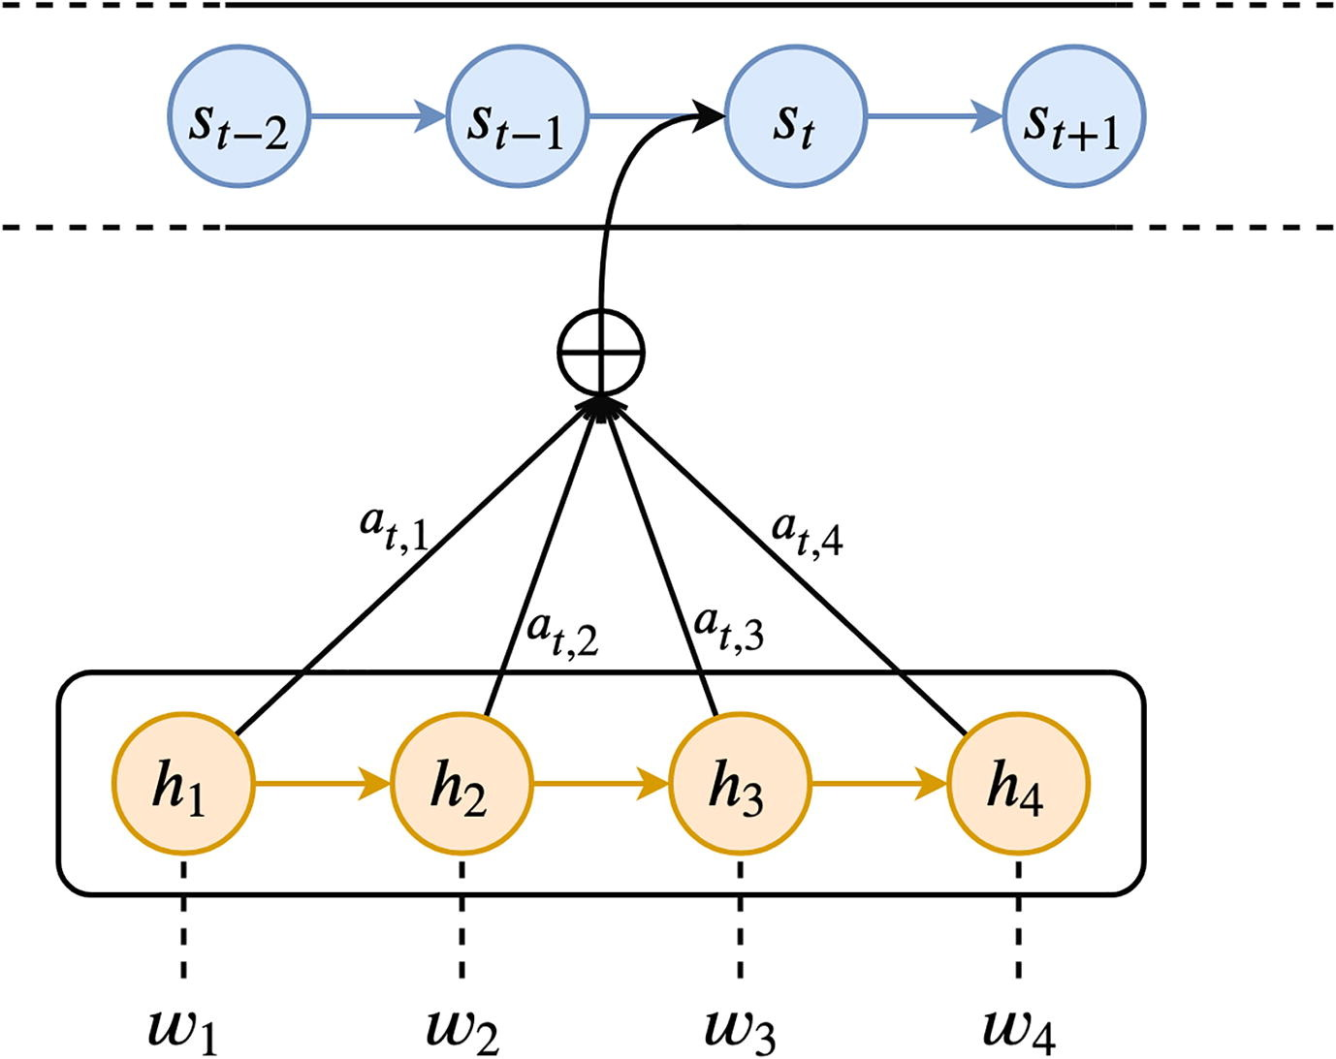
Advances in NLP: Attention mechanism
Long sentences can’t be compressed into fixed length vector representation. To overcome this, attention mechanism was proposed.
The output state is computed as a linear combination of all context vectors.

Slide 13
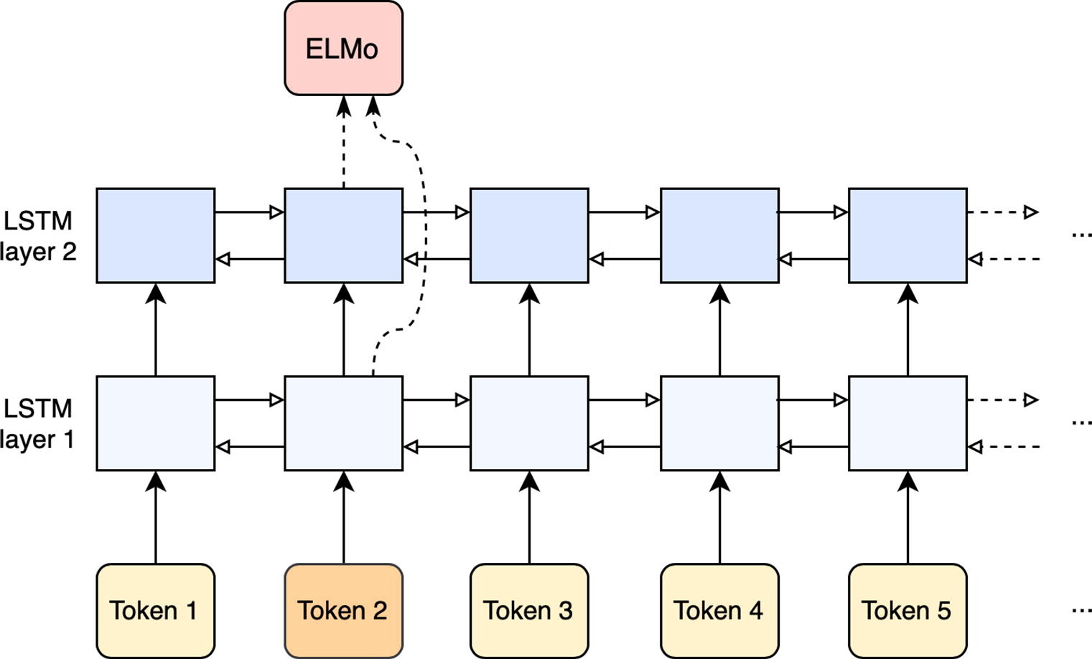
Advances in NLP: ELMo
Instead of using a static word vector, ELMo looks at the entire sentence producing a contextualized word embedding through a bidirectional language model.

Slide 14
Advances in NLP: Transformers
Transformer is the first architecture entirely based on attention to draw global dependencies between input and output, replacing the recurrent layers most commonly used in encoder-decoder architectures.
BERT kicked off the game!
Then we had RoBERTa, ALBERT, DistilBERT, MultilingualBERT and many more.
And of course the latest GPT-2/3/4…

Slide 15
Software
Low Level Module: Tokenization, POS tagging
High Level System: Document Classification, Models

Slide 16
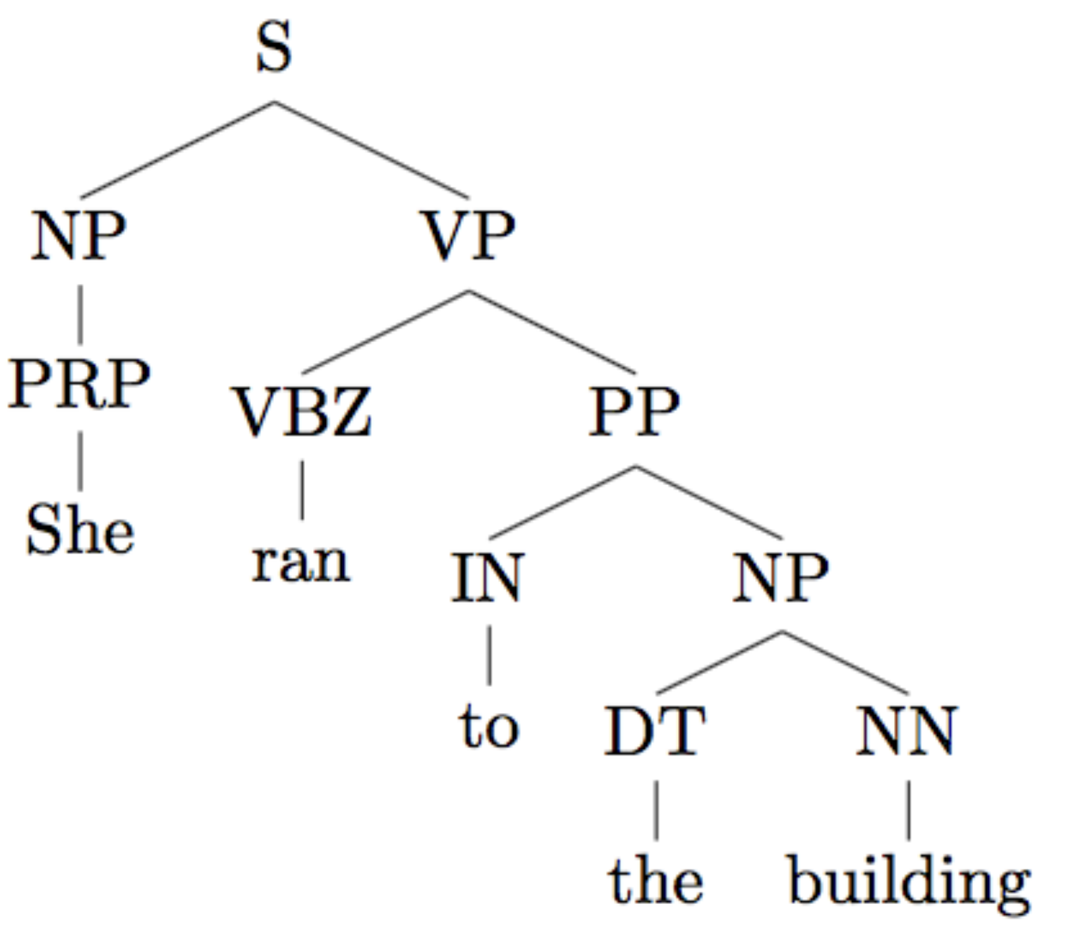
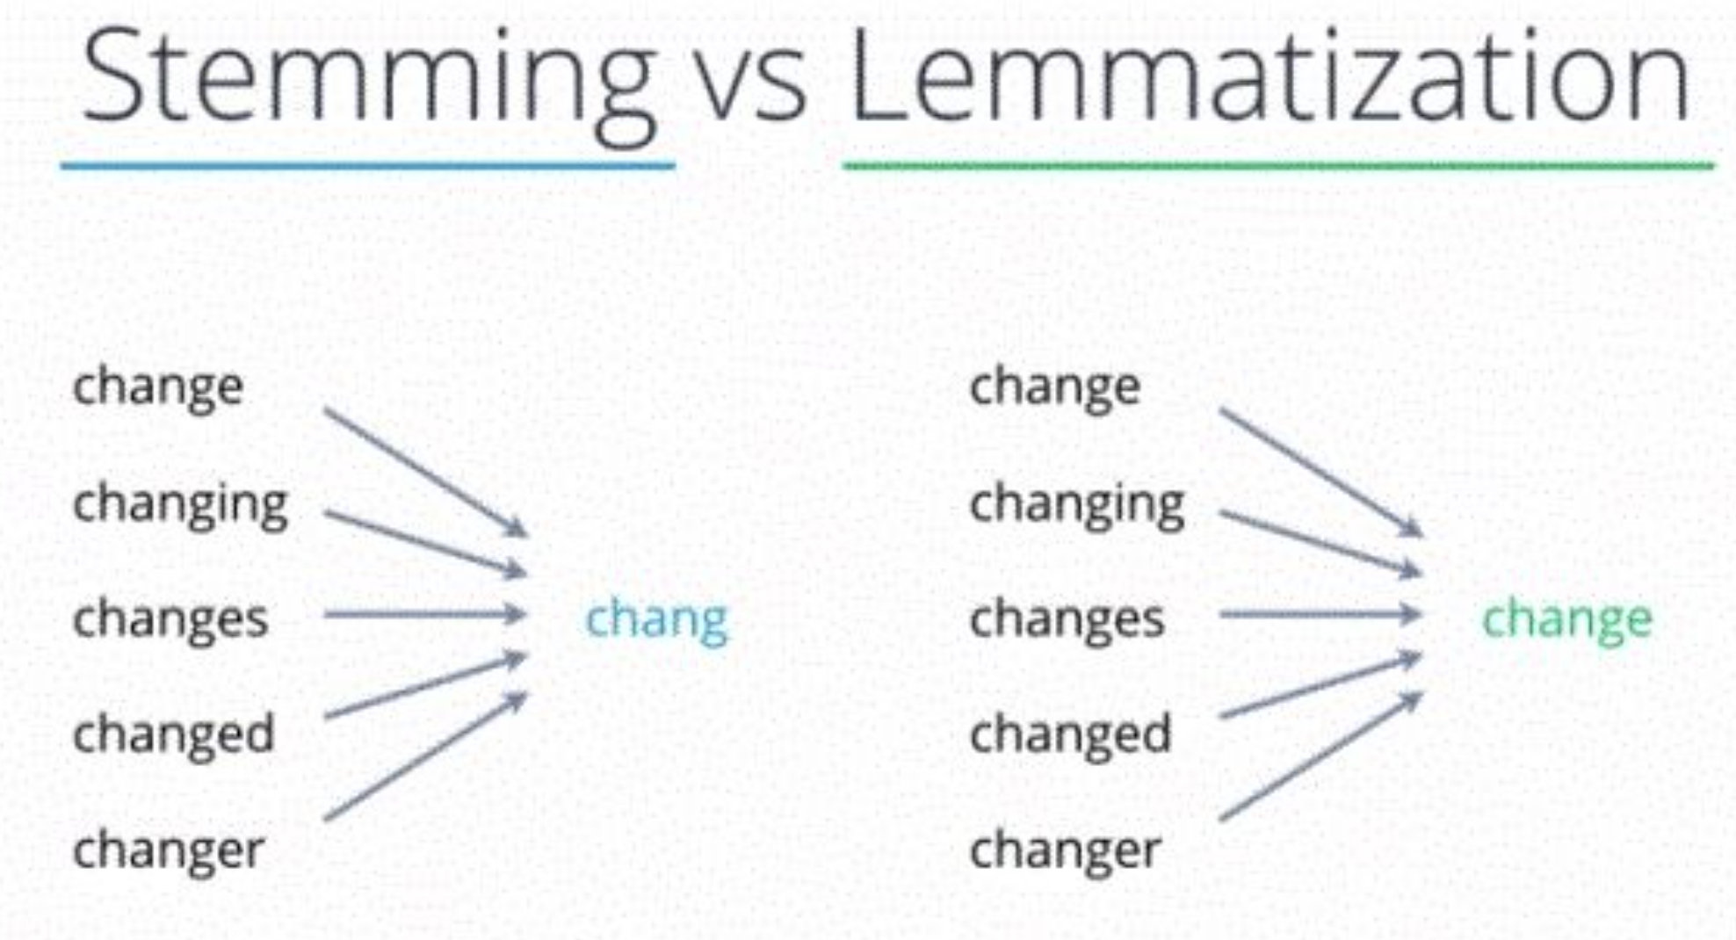
NLTK
Good for low level tasks
Tokenization, stemming, tagging, parsing

Slide 17
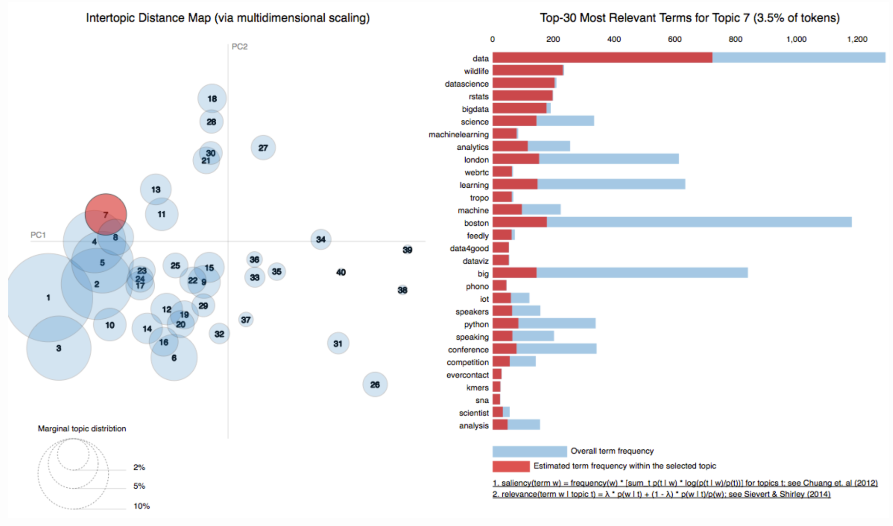
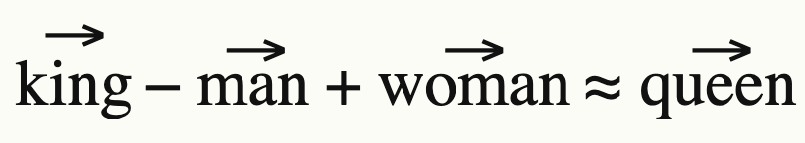
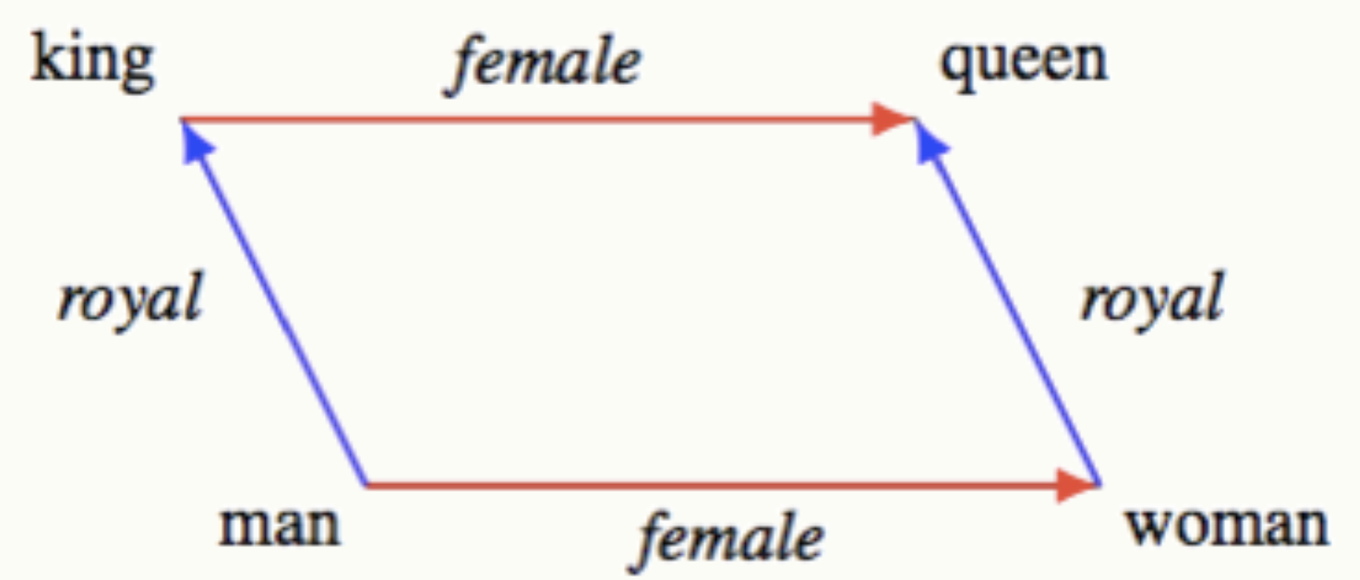
GENSIM
Topic Modeling, Text similarity
Popular in Information Retrieval and NLP communities
Word2Vec (pretrained)
Algorithms: LDA, HDP

Slide 18
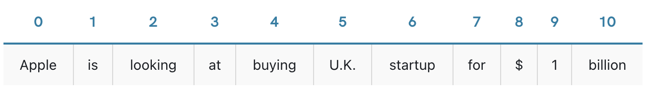
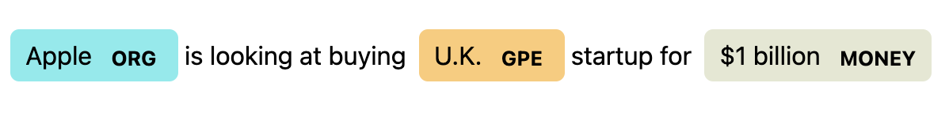
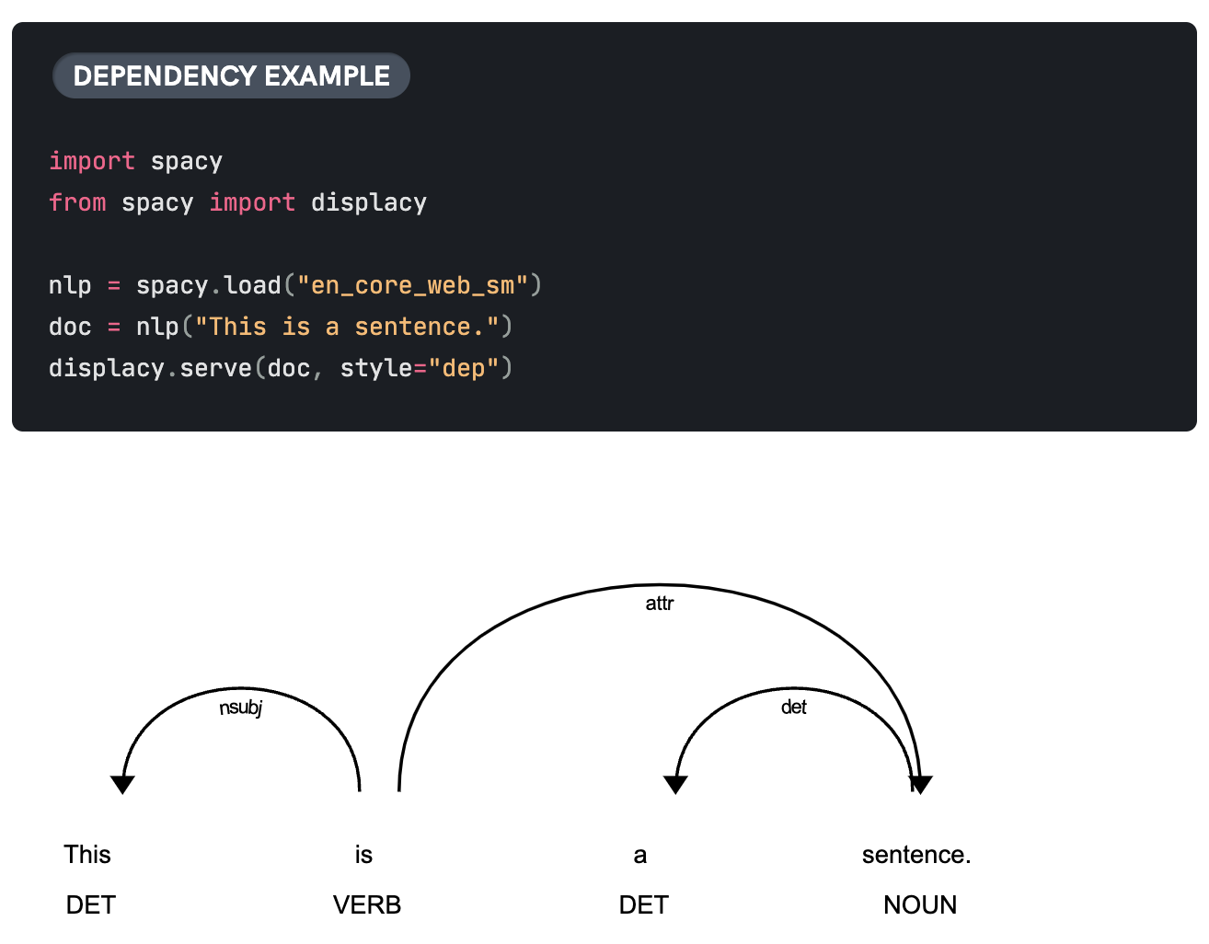
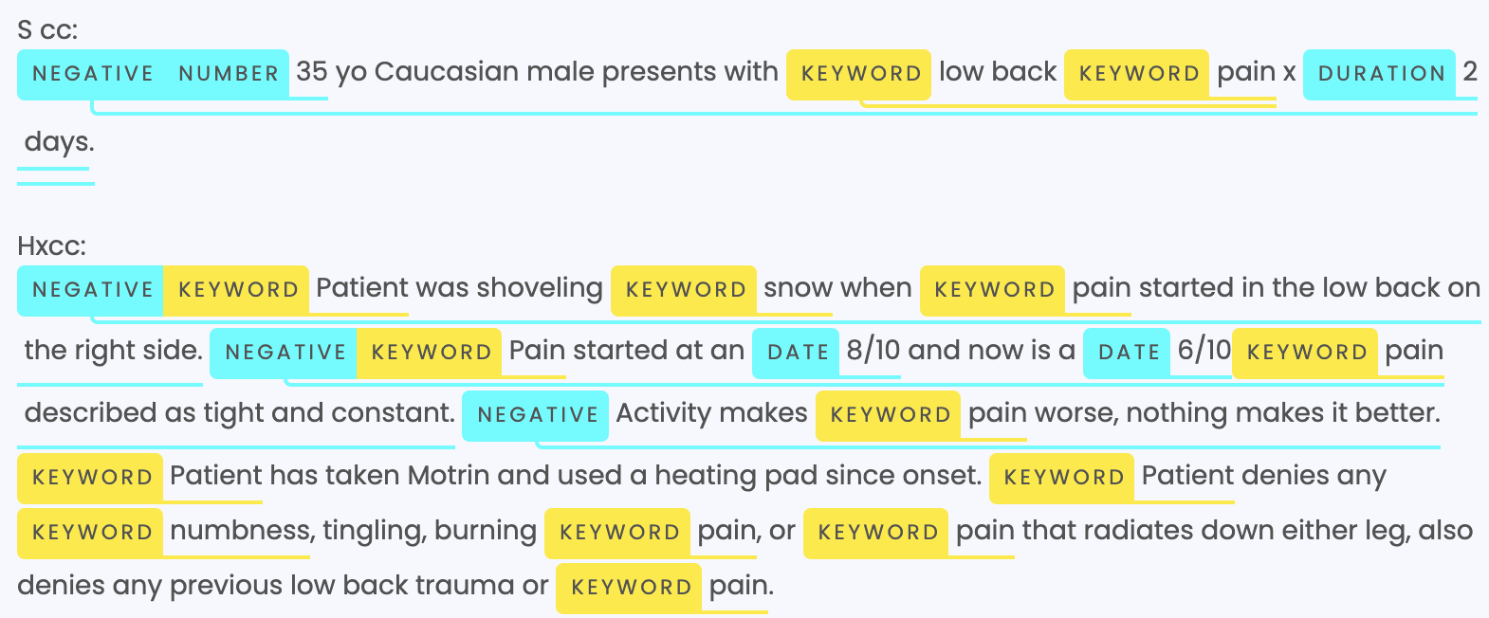
Spacy
Named entity recognition (NER)
Sentence Segmentation
POS, Dependency Parsing

Slide 19

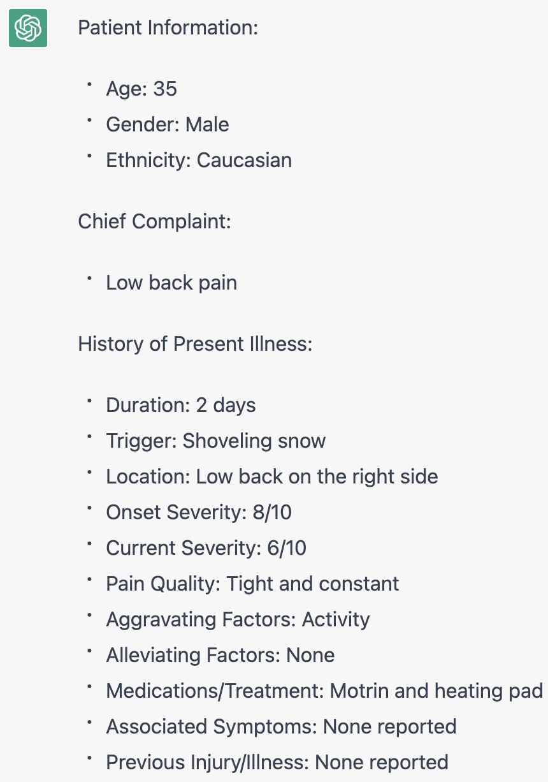
Transformers
General Purpose Architectures (Pretrain, Downstream)
BERT, GPT-2, RoBERTa, XLNet
Natural Language Understanding, Natural Language Generation
Pre-trained Models
Multi Language ( 100 + )
Tensorflow, PyTorch

Slide 20
Core NLP and Stanza
POS, tokenizing, parsing, NER
Based on JAVA
Stanza: python interface for Core NLP
Tools for biomedical and clinical tasks

Slide 21
Hardware
Training speed
Memory
Efficiency(Thermal Design Power)
Cost

Slide 22
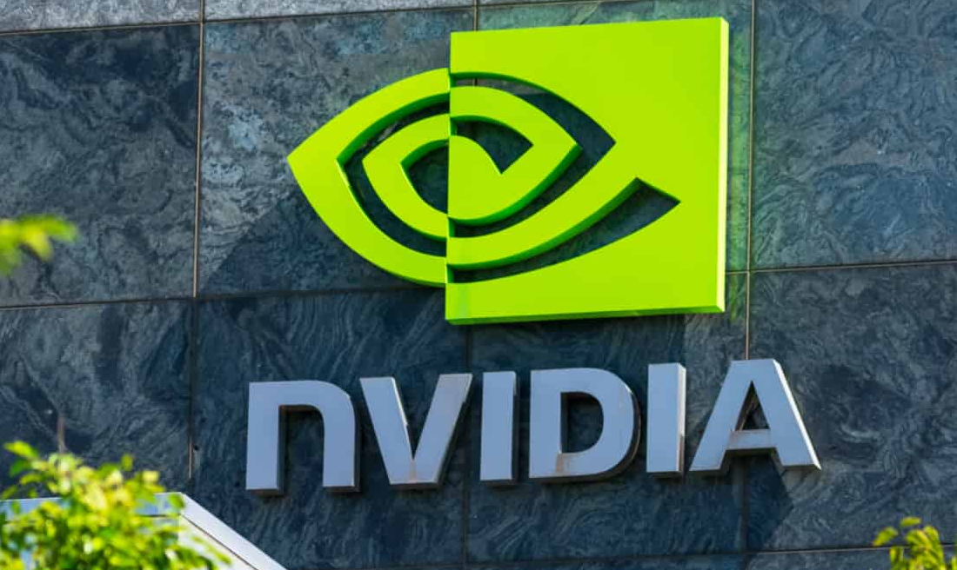
Popular GPUs
Nvidia Tesla V100: paired with 16 (or 32) GiB of memory
Nvidia Tesla A100 Paired with 40 GiB of memory
Nvidia Tesla T4 Not very fast, but low power consumption
Nvidia Tesla K80 Widely used in the past, extremely cheap nowadays
Nvidia Tesla M60 Price higher than K80.
Intel Xeon E5-2686-v4 Popular CPU

Slide 23
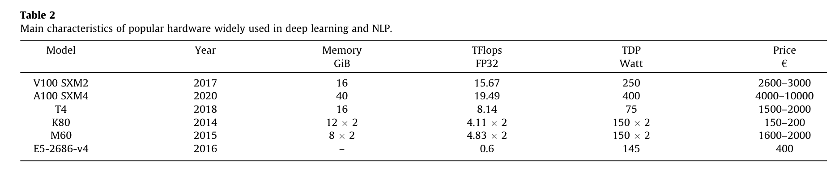
Comparison of Specs vs Price of hardware

Slide 24
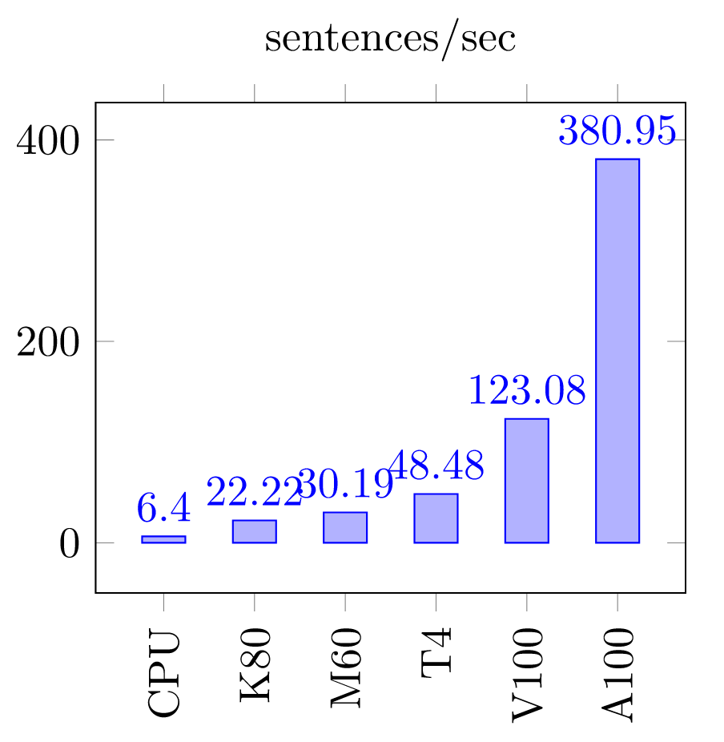
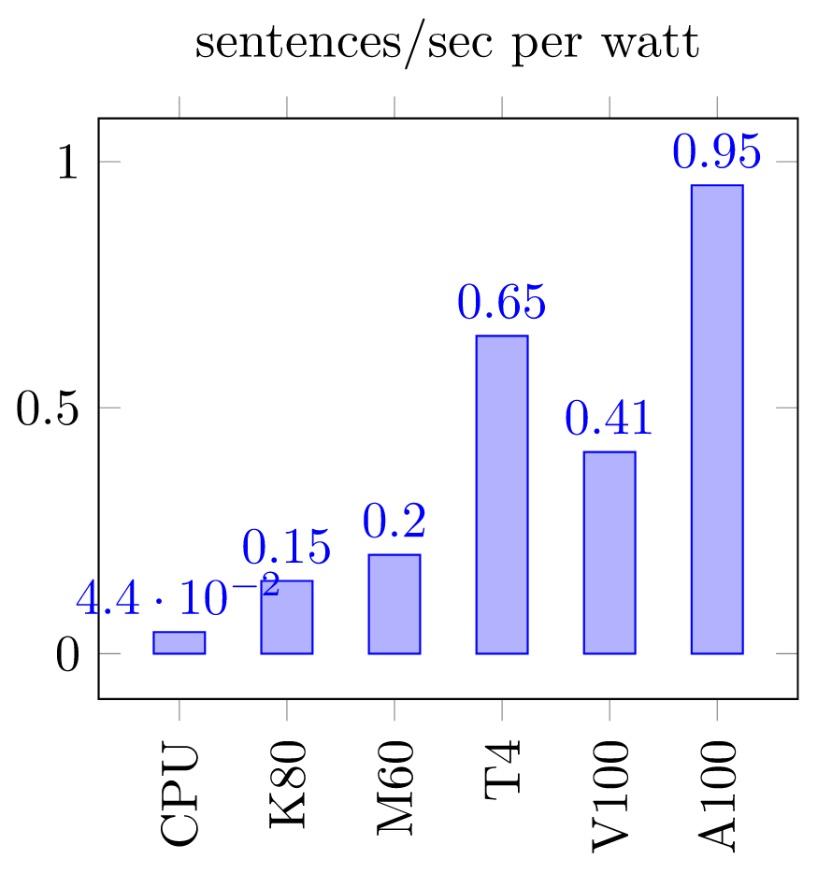
Hardware speed when fine-tuning BERT-base-uncased pre-trained model.
Hardware speed per watt when fine-tuning BERT-base-uncased pre-trained model.

Slide 25
Datasets: Question Answering
Answer Sentence Selection (AS2)
Selecting the sentence constituting the answer.
Machine Reading (MR)
Identifying the exact text span representing the answer.
Stanford Question Answering Dataset (SQuAD-1.1)

Slide 26
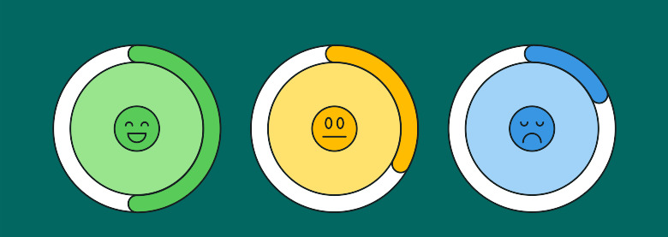
Datasets: Sentiment Analysis
Product Reviews
IMDB Movie Reviews Dataset: 50,000 movie reviews of which 25,000 are labelled as positive intent and 25,000 as negative.
Twitter dataset
1,400,000 tweets
User responses to different products, brands, or topics through user tweets.
Challenges: Irony, Sarcasm

Slide 27
Datasets: Sentiment Analysis
Paper Review Dataset
405 reviews of scientific papers, and they are labelled with a score from 2 (very negative) to 2 (very positive)
Multimodal Dataset
IEMOCAP: 12 h of audiovisual data

Slide 28
Datasets: Biomedical text mining
Biomedical NER (BioNER)
Focus: Extract relevant Biomedical entities, such as proteins, chemical compounds, or organism names from Biomedical documents
Concept Recognition
Relation Recognition
Biomedical Semantic Indexing (BioSI)
Classifying Biomedical documents according to a hierarchy labels
large-scale corpora consisting of tens of millions of documents manually annotated by experts, representing the most important resources in BioSI

Slide 29

Datasets: Machine Translation
OPUS
Collection of translated texts from the web
MultiUN
Collection of translated documents from the United Nations.

Slide 30
Datasets: GLUE and other benchmarks
General Language Understanding Evaluation(GLUE)
Single sentence understanding, sentence-pair tasks
SUPERGLUE: more challenging task
Biomedical Language Understanding Evaluation (BLUE)

Slide 31
Current Issues and Future Directions
Issues
Computation Cost, huge parameter size
Difficulty in hyper parameter tuning resulting in reproducibility issues
Output: Hardly interpretable
Future Directions
Cyber-security, such as fake news detection
Industrial applications, such as virtual assistants (Alexa, Siri...),
Text generation based for instance on recent variational autoencoders or Generative Adversarial Networks.

Slide 32
Any Questions?

